Slide 1
Kubernetes(Design)
Written by Ted.J
jongnag@gmail.com

Slide 2
Philosophy
Cluster per Tenant Model
DK(V3) on top of Openstack
Align DK(V3) to Openstack AMAP
Calico, be used as a Network plugin (peering to RR not physical router)
Storage options are required (i.g, Block, NFS - TBD)
* Leverage “Kubespray” as a tool for deployment of K8S

Slide 3
Chosen items for Designing
Details Regarding items
Naming
Network
Deployment
H/A
Backup & Recovery
Administration
* Attachments

Slide 4
Design (I)
Items
Group | Items |  | object | Interface to | How
* S/W Package | OS PHP Env Ansible Docker |  |  |  | Ubuntu 16.04 PHP 2.7> Phy-netaddr (network address manipulation) Ansible 2.7> Docker 1.12
* Naming (naming ruled by DK V3) | Region |  | DC
 | Namespace |  | Service, pod | Types in K8S | Just create by the pre defined rule
 | Tenant |  | Tenant | Openstack (Project) | Synchronize the name of VM with the name of K8S
 | Cluster |  | context | File (admin.conf) | Replace generated value with new value(tenant)
 | Hosts |  | Node (master, worker) | Manually update name of role to every worker nodes | Server type (cpu, mem, gpu, data I/O) “Role by label” is the mark to make them act the way expected. * deploy container onto designated worker nodes (nodeselector)
 |  | Role by label
* Deployment | Automation |  | Configuration file | Ansible by Kubespray | Set values in the parameter of each tasks on various files (i.g Inventory.cfg *.yml)
* Network | CNI-Plugin |  | Calico (BGP, IPIP) | Script (ansible) | set input values onto Kubespray when create cluster Kubespray
 | Route reflector |  | workers |  | Create a vm and configure every workers under it * RR / 100 worker nodes
 | IP range/Cluster |  | workers | Script (ansible) | set input values onto Kubespray when create cluster
* HA | Master |  |  |  | Odd number / min three (use Single LB or leverage ubalance)
 | LB Integration |  |  |  | Physical LB(K8S-API), Logical LB(Ingress Controller)
 | K8S DNS |  |  |  | HA of KubeDNS (Service Discovery)
 | ETCD cluster |  |  |  | Run ETCD cluster on the same place with masters * For making highly resilient stable cluster (odd number 3,5,7)
Notes:
In Kubernetes, a controller is a control loop that watches the shared state of the cluster through the apiserver and makes changes attempting to move the current state towards the desired state

Slide 5
Design(II)
Items
Group | Items | object | Interface to | How
Backup & Recovery process | Host(VM) failure | Host |  | Remove node from K8S, Add new node to current cluster by step in manual
 | Node failure | Node |  | Tune parameters of controller & kubelet (slide #11) Add new worker node using Kubespray * Master: just add a new master * Ingress controller: build containerized ingress controller (required feature verification)
 | Disk fault | Disk
Administration | Resource Manage | Node scaling | Script (ansible) | Monitoring
 | Security | Token, TLS | Type regarding security | Role binding and mapping
 | Upgrade | Cluster, Single components | Script (ansible) | Components
 | Node Handling | Node sizing (add/remove) | Script (ansible) | Add-Kubespray with configuration files, Remove (Rest API , client Kubectl)
 | Monitoring | Calico ETCD Main Processes of K8S | API | Calico container keep alive check Status check (ETCD cluster) Main processes (K8S)
 | Logging |  |  | Kemi * fluent agent(td-agent)/worker * Issue log data into files on host directory (/var/log/tenant, given privilege)
 | Quota | CPU, Mem | API | n/a ( by tenant )
 | Backup | File: admin.conf, Directory: /etc/kubernetes/* Directory: /var/lib/etcd/*, Directory: /var/backups/etcd* Directory: /etc/calico ~/kubespray/Inventory.cfg |  | Store files at storage or Store serialized object into DB * use kakao backup tool, daily backup (keep for a month)
Storage (TBD) | Storage Type | Local(HDD/SSD), Remote(Block/Object/NFS) |  | Kubernetes (PV, PVC) URL over network
Authentication(TBD) | Tenant | Tenant, Serivce, KubeAPI |  | Adapt the auth module from V2

Slide 6
1. Naming
Example
 |  |  | Openstack | DK V3 | Example
VM Tier | Layer 1 |  | DC | DC | region1
 | Layer 1-1 |  | DC | Zone | zone
 | Layer 2 |  | project | tenant | region1-zone-tntA (user defined)
 |  | Layer 3 | vm Name for master vm Name for worker vm Name for rr | Name of Master, Name of Worker : role (label) Name of RR | region1-zone-tntA-master-#n *initiate three masters, add more node for scaling & ha region1-zone-tntA-worker-small-#n, tntA-worker-medium-#n, tntA-worker-large-#n region1-zone-tntA-worker-highmem-#n, tntA-worker-cpu-#n, tntA-worker-gpu-#n Define role to worker node * The name of workers could be updated by user region1-zone-tntA-rr-#n * Exercise is required in detail (how does it work, what it is)
K8S Tier | Cluster |  |  | Name of Cluster | region1-zone-tntA-CLUSTER-#n
 | Context |  |  | Name of Context | region1-zone-tntA-CONTEXT-#n
 | Namespace |  |  | Name of Namespace | region1-zone-tntA-NS-?????
 | Service |  |  | Name of Service | region1-zone-tntA-NS-SVC-????
 | Label |  |  | Name of Group’s name | region1-zone-tntA-LBL-????
Role | Workers |  |  | All Worker nodes | Role: general Role: user define Role: Ingress (acts like marathon LB) Role: SSD Role: GPU Role: Mem

Slide 7
1. Naming
Examples
Cluster (=context)
Cluster (=context)
Label
Label
Cluster (=context)
region1-tnt-Cluster (tnt-context)
label
label
label
region1-tntA-NS-SVC-LBL-****
region1-tntA-NS-SVC-****
region1-tntA-NS-****
Service
Service
svc
svc
svc
Kubernetes word
Namespace
Namespace
namespace
namespace
namespace
Context
Context
Cluster
Cluster
DK
region1-tnt-woker1-001
Hi IOPS
GPU
Hi Mem
Physical
machine
Hi-mem
Physical
machine
Both words
(Openstack, Kubernetes)
PM
worker
masters
workers
rr
region1-tnt-woker1-001
(the same name as Openstack)
Openstack
vm
vm
vm
vm
vm
vm
vm
vm
vm
vm
Physical
machines
region1-tnt-woker1-001

Slide 8
2. Network
Why Calico?
No reason, it is a better solution as of now for container networking.
It uses protocol bgp with peering others in autonomous way. (simple)
No configuration by operator (easy to operation)
Alternate solution? Romania

Slide 9
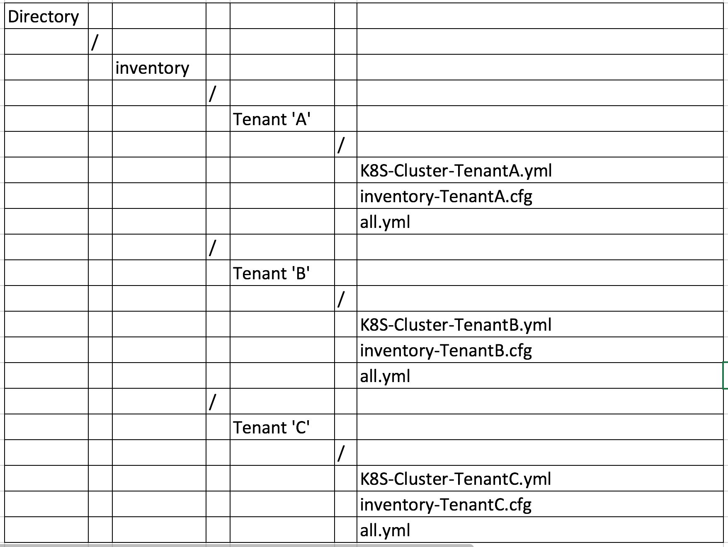
2. Network
Rule
Easy to operation (BGP, best solution among CNI plugins currently)
BGP peering to Route Reflector
Allocate unique IP ranges to each Tenant separately
* Inject this value into the each line of Kubespray (inventory.cfg, k8s-cluster.yaml)
Target files,be used by kubespray, will be updated regarding every attributes of network
Tenant(Services) | Pod IP Ranges
Tenant ’A’ | 10.233.0.0/18
Tenant ‘B’ | 10.233.64.0/18
Tenant ‘C’ | 10.233.128.0/18
Service ‘A’
Service ‘B’
Service ‘C’

Slide 10
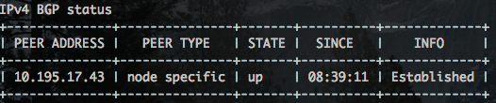
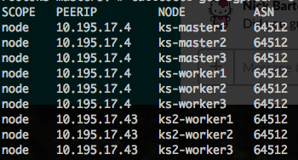
2. Network
Peering
Not full-mesh by nodes
* Every master & worker nodes peer with route reflectors
More performant & simpler than full-mesh architecture
Pl, check ”up and run” status of calico like below.
One row will come out because of only peer to RR1
Each group peers with route reflectors
RR1
RR2
RR1
100 workers
100 workers
Hi IOPS
GPU
Hi Mem
Hi IOPS
GPU
Hi Mem
rr2
Workers grouped at ‘A’
Workers grouped at ‘B’
rr1
* Peering (how, where , method)

Slide 11
3. Deployment
Rule
Two options (manual, automated)
Proceeding K8S deployment process after Openstack
Set name of VM uniquely to identify
Create file for deployment per Tenant
1
Create VMs
‘
Step1
. Create VM for a Tenant(=Service)
: start with “TENANT-Servicerole” for VM
. Collect VM IP by Role or Name
UI (DK V3)
2
1
‘
Return server lists
2
Step2
. Build script with returned values from Step1
Openstack
Build scripts refer to related files
Storage or DB
4
Kubespray
Step 4
Return value with message
3
Step 3
Execute Kubespray with referring file Injects file
- K8s-cluster.yaml
- Inventory.cfg
VM
VM
VM
VM
VM
VM
RRs group
Masters group
Workers group

Slide 12
4. HA
To ensure the stable operation of the cluster
Three points for high availability
Point #1
Point #2
Point #3
Kubernetes Cluster
: kube-apiserver,
kube-controller-manager,
kube-scheduler
: kube-proxy,
kubelet
ETCD Cluster
Kube-DNS
1
2
3
4
5
Cloning by itself
Load Balancer for API Server
. Internal (nginx)
. External (LB with VIP)
Adjust some *parameters
of each static pods
Containerized cluster (this time)
Physically isolated Etcd cluster
* Initialize with five nodes
Discovery name of every services
Ref
* parameters
https://kubernetes.io/docs/reference/generated/kube-controller-manager/
https://kubernetes.io/docs/reference/generated/kube-proxy/
https://kubernetes.io/docs/reference/generated/kube-apiserver/

Slide 13
5. Backup & Recovery
Backup-Configuration
Backup every configuration files & keys for an emergency status to Storage or DB
. Option1: Store file to storage
. Option2: Store file into DB as a blob data
Objects: K8S, Etcd, Calico, Kubespray
UI (DK V3)
Store the group of files into specified directory of each tenants
File into DB as type blob
: put/get
Cluster For tntA
Cluster For tntB
Cluster For tntC
Cluster For tnt#N
blob
blob
blob
files
File: admin.conf,
Directory: /etc/kubernetes/*
Directory: /var/lib/etcd/*, Directory: /var/backups/etcd*
Directory: /etc/calico
~/kubespray/Inventory.cfg
tntA
tntB
tntC
tnt#n
blob
Storage
blob
Database
(MySQL)

Slide 14
5. Backup & Recovery
Objects for Recovery
Monitoring (process & log)
Scan issue point
Overcome?
no
yes
Process | Process (=Rebuilding)
Trouble shooting Trace issue Use tool Should know exact point to fix it to make recovery time & process short
 | Openstack | DK(V3) | Answer | Solution
Host | VM | Bare | Create | Horizon(UI) or API
Node | process | Node | Create | Execute Kubespray
Process | process | Static Containers | Re-run Static Pods | Kubectl, Calicoctl
App | process | Service | Deploy Service | Re-run yaml

Slide 15
TBD (with KEMI)
6. Administration (Monitoring)

Slide 16
6. Administration (Logging)
Option1
Option2
Kubernetes
None
Json-file(default)
Syslog
Journald
Gelf
Fluentd
Awslogs
Splunk
Etwlogs
Gcplogs
logentries
None
Json-file(default)
Syslog
Journald
Gelf
Fluentd
Awslogs
Splunk
Etwlogs
Gcplogs
logentries
Container
Host
Backend
Log messages
docker
Fluentd
agent
Docker
Logrotate
/var/log/containers
Enabling an option for logging is required for Docker
: --log-opt max-size=50m --log-opt max-file=10
Rotate container stderr/stdout logs at 50m and keep last 5
Replace default with any one of drivers

Slide 17
6. Administration (Upgrades)
Purpose: To get benefits new types of K8S
Upgrade Kubernetes Cluster
: manual or automated→ whole processes handled by DK(V3)
UI (DK V3)
5
Query Result (success, fail)
Command: Upgrade
Target Cluster: #002
Object: Workers, ETCD
Tenant “A” , Cluster Name: “#001”
1
Ready status
3
Configuration update
with parameters
VM
VM
VM
VM
VM
VM
2
RRs group
Masters group
Workers group
Tenant “A” , Cluster Name: “#002”
Store configuration
Kubespray
tntA
tntB
tntC
tnt#n
4
VM
VM
VM
Execute
VM
VM
VM
Storage
RRs group
Masters group
Workers group
Tenant “B” , Cluster Name: “#001”
VM
VM
VM
VM
VM
VM
RRs group
Masters group
Workers group
* Upgrade in the order

Slide 18
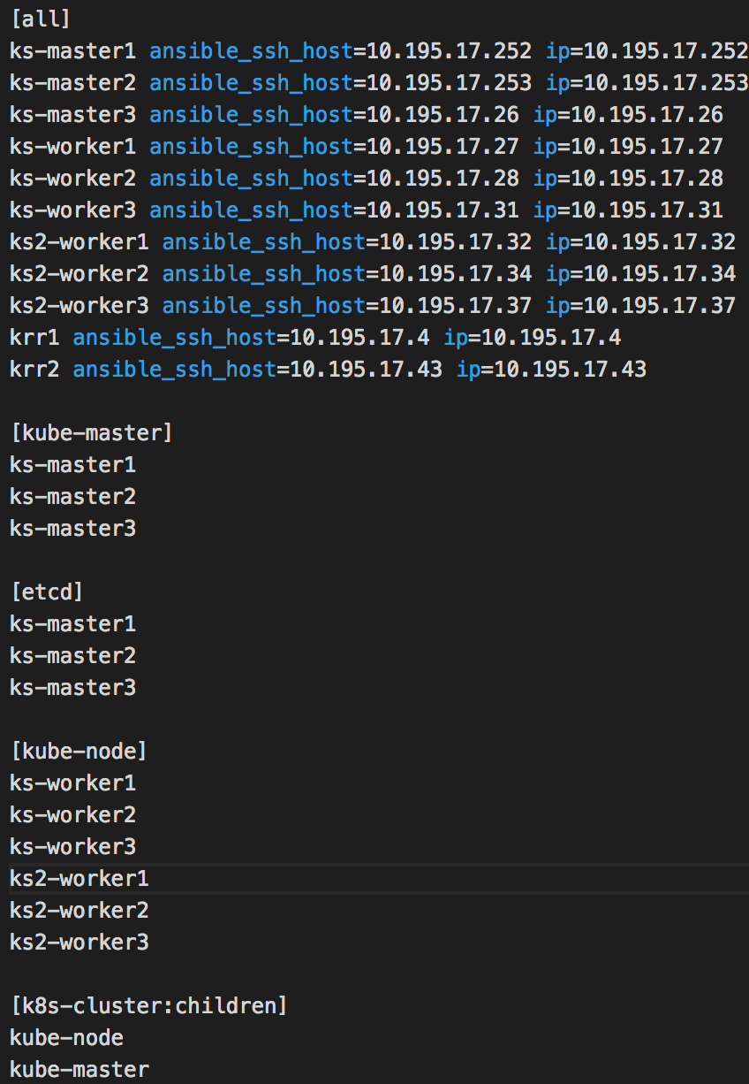
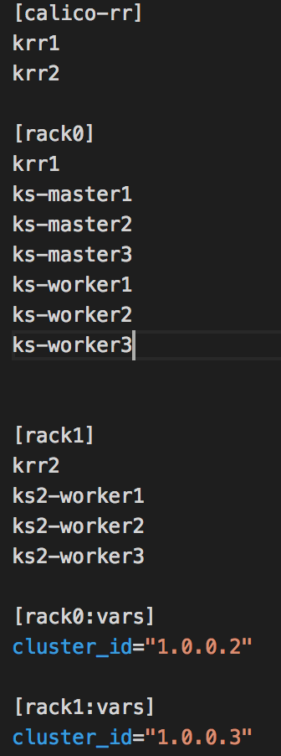
6. Administration (Cluster sizing)
Adding nodes
. How
→ just add worker nodes to existing target cluster
. Command (re-run “cluster.yaml” ansible playbook)
→ example in below
1
Create VM
: Names of VMs, IPs of those VMs
2
Edit inventory.cfg with the return values
: add line of each directives
: it may be workers….so, [all] / [kube-node] / [rack~]
3
Do an execution
: ansible-playbook –I ~/inventory.cfg scale.yml –b -v
4
Verify
: can check with kubernetes client (kubectl)
: kubectl get nodes
: calicoctl get nodes , calicoctl node status (be peered well?)

Slide 19
* Next ….
Build Federated Clusters, which is managed by DK(V3)
: referring the saved configuration of each cluster
as a result, can mange centralized K8S cluster across regions
UI (DK V3)
Federated Cluster
Action: switch cluster
Scope: region1 cluster
Do: execute commands
Configurations
(=environment data)
ctxt A
ctxt B
ctxt B
Region: seoul
Region: region1
K8S Cluster
(context=ctxt A)
K8S Cluster
(context=ctxt B)
K8S Cluster
(context=ctxt C)

Slide 20
Execution Plan
<30 Days, Focus on Kubernetes>
15/Jan | 16 | 17 | 18 | 19
22 | 23 | 24 | 25 | 26
29 | 30 | 31 | 1/Feb | 2
5 | 6 | 7 | 8 | 9
Cutting & Breaking Kubernetes Cluster
Installation & Configuration(paramters)
Process Analysis
Concept & Kubectl Command (svc, pod, label, deployment, daemonset)
Failover
Monitoring
Scaling
Cutting & Breaking Kubernetes Cluster
Management
Concept & Kubectl Command (Ingress, Replicaset, Role, ServiceAccount, SVC Rolling Upgrade)
Calicoctl Command with various options
Etcdctl Command with
Various options
Basic
Upgrade(K8S, Calico, ETCD, ETC ),
Monitoring & Logging ,
Scaling, HA, Recovery
Service
(container)
Debugging(k8s, docker)
Main process
Debugging
Kubernetes
Exercise Service Deployment (3 tiers)
Debugging(k8s, docker)

Slide 21
Attachements

Slide 22
Attachments – Peering (store env at ETCD)
Return
The configuration regarding Route Reflectors is stored at ETCD for IPV4 & IPV6
/ (root)
/calico/bgp/v1/rr_v4
/calico/bgp/v1/rr_v6
* Pl, check version ETCD (v2)
Calico
RR
ETCD
Directed by inventory.cfg
Calico
Agent
Query
Insert/update
2
1
3
IP return
/var/lib/etcd
/var/backups/etcd*
4
Automatically, Registered
* Do a command to create Calico RR. (https://hub.docker.com/r/calico/routereflector/)
docker run --privileged --net=host -d -e IP=10.20.5.125 -e ETCD_ENDPOINTS= https://10.20.10.252:2379,https://10.20.10.253:2379,https://10.20.10.3:2379 calico/routereflector:v0.4.0
docker run --net=host --privileged --name=calico-rr -e IP=${IP} -e IP6=${IP6} -e ETCD_ENDPOINTS=${ETCD_ENDPOINTS} -e ETCD_CA_CERT_FILE=${ETCD_CA_CERT_FILE} -e ETCD_CERT_FILE=${ETCD_CERT_FILE} -e ETCD_KEY_FILE=${ETCD_KEY_FILE} -v /var/log/calico-rr:/var/log/calico -v /etc/calico/certs:/etc/calico/certs:ro --memory=1000M --cpu-shares=300 quay.io/calico/routereflector:v0.4.0

Slide 23
Attachments – Upgrades/Single unit
Return
Can be upgraded in the order in which they were install (in Kubespray)
Single item can be upgraded indivisually (Docker, Kubernetes, Etcd)
boom
Add-on(kubedns)
Verify version by kubectl
> Kubectl version
> both(client, server) versions should come out
4
Network Plugin
Calico_cni
Verify version by calicoctl
> Calicoctl version
Calico
3
Kubernetes
2
Docker
Verify version by docker
> docker version
1
* Example
ansible-playbook upgrade-cluster.yml -b -i inventory.cfg -e kube_version=v1.9.0
A file(upgrade-cluster.yml) must be used against 1 kube-master already deployed.

Slide 24
Attachments – How does requests be delivered & communicated in Kubernetes
Process point of view
Kube-apiserver
Kube-apiserver
8080
Kube-apiserver
6443
nginx
Kube-Controller-manager
Kube-Scheduler
Kube-Proxy
etcd
Kube-Proxy
Kubelet
Kubelet
* confd
* confd
Node point of view
RR1
RR2
RR3
* confd
* confd
* confd
Master
Master
Master
Worker
Worker
* confd
Worker
Worker
Worker
Worker
Worker
Worker
Worker
Worker
Worker
Worker
Worker
Worker
Worker
Worker
Worker
Worker
Worker
Worker
Worker
Worker
Worker
Worker
*confd: keeping local configuration files up-to-date using data stored in etcd

Slide 25
Attachments – LoadBalancer Type
Return
(K8S)API Server
(K8S) Service
Internal Traffic
External Traffic
Service Traffic
K8S(API)
InLB(nginx)
ExLB(H/W,S/W)
DNS
LB(Ingress controller)
(Nginx, HaProxy)
Kubelet
Kubeproxy
K8S(API)
Service
Pod
container
container
traffics between main daemons
traffics heading to API from clients
traffics heading to Containers from clients

Slide 26
Types of Kubernetes & Relationship between them
Service
Pod
Ingress
Controller
Ingress
rule set
Endpoints
Ingress
Controller
Kubernetes API
monitoring
Ingress
(rule set)
Endpoints
NetworkPolicy
rules
Developers
switching between clusters by context
Limits
Region-asia1
(Resource, cpu/mem)
Cluster
Namespace
Pod
Cluster
Namespace
Service
Pod
Headless service
Container
StatefulSet
Federation
ClusterIP (internal)
--------------------------
Nodeport
Loadbalancer
ExternalName
Port proxy
Container
Cluster
(=context))
CPU
Cluster
(=context))
1:N
N:M
1:N
CPU
Region-asia2
1:N
GPU
(applications on stateful)
GPU
Mem
Mem
Ordinal index
Stable NetworkID
Stable Storage
Cluster
TLS(Certificate signing Request)
ConfigMap
Horizontal pod Autoscaler
(cpu,mem,custom)
stateless
sync controller by
federation controller manager
demonset
secret
configmap
Deployment
Persistent
VolumeClaim
(Size,Mode)
Rollout & Rollback
Update image
Replicaset
Scaling a deployment
Pause & Resuming
* pod updating
ReplicaSets
Certificate
Signing
Requests
stateless
StorageClass
kubeadm join with token
-provisioner
Ceph/Gluster/AWS/
Ccloud/NFS/iSCSI
-parameter
(size, access mode)
(No NS)
Replication
Controller
Persistent
Volume
(No NS)
kubernetes
package
CoreDNS
Secret
Service
Account
Service
Account
Operator
ThirdPartyResources
Node
(Node selector)
Helm
DNS entry
Token
(kubeadm –ttl=0)
RBAC
ClusterRole
ClusterRole
Binding
Role
Binding
Role
DaemonSet
KubeDNS
rules
rules
service-name.namespace-name.svc.cluster.local
namespace or all namespaces
the same namespace
Job

Slide 27
* Calico https://hub.docker.com/r/calico/routereflector/ https://docs.projectcalico.org/v2.2/usage/routereflector/calico-routereflector * Kubespray https://github.com/kubespray/kubespray-cli * Monitoring https://www.datadoghq.com/blog/monitoring-kubernetes-era/ * Dashboard https://github.com/kubernetes/dashboard https://github.c https://github.com/kelseyhightower/confd/blob/master/docs/quick-start-guide.md om/kubernetes/dashboard/wiki/Creating-sample-use * etcdctl https://github.com/coreos/etcd/tree/master/etcdctl * deploy sample https://github.com/microservices-demo/microservices-demo/tree/master/deploy/kubernetes
Doc Reference

